Slide 1
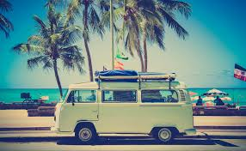
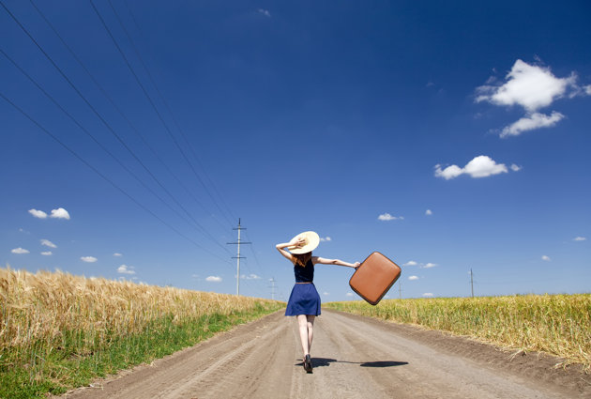
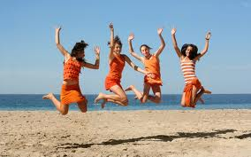
Unit 1 - Travel
Chapter 1: Scanning/ Organizing Vocabulary
Chapter 2: Predicting/ The prefix -off

Slide 2
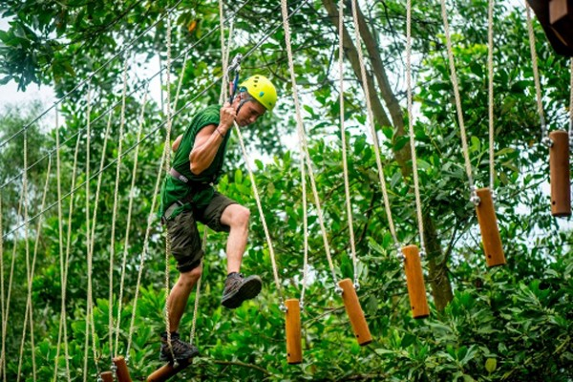
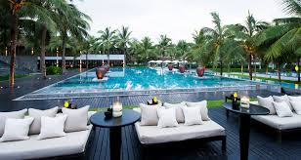
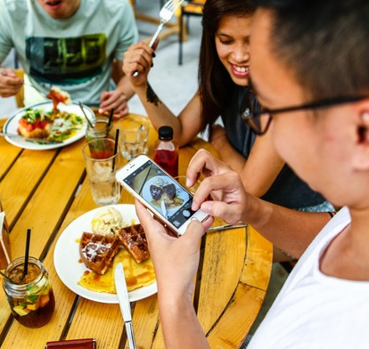
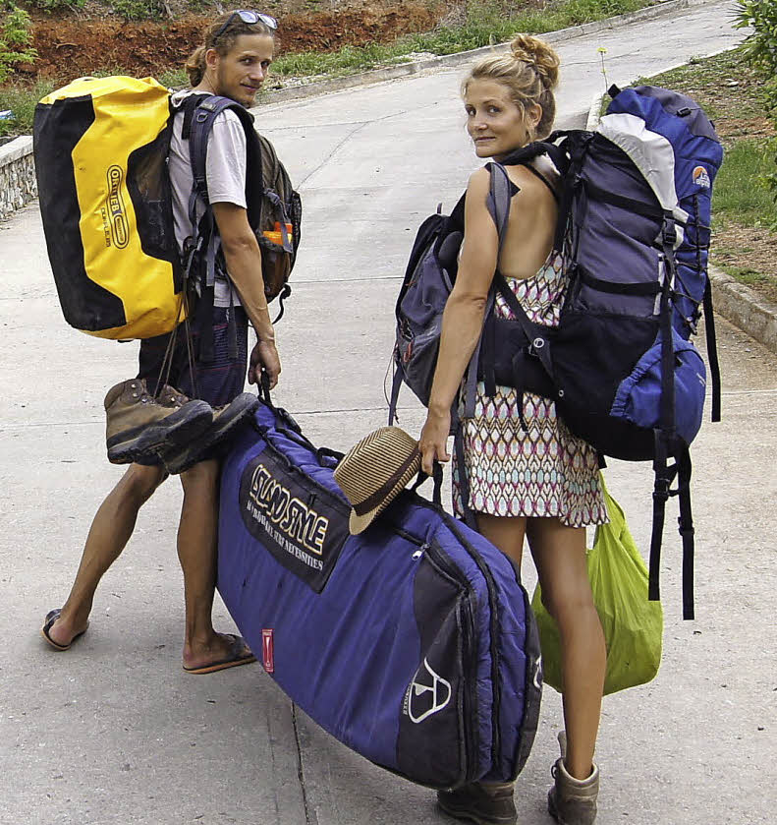
Getting ready
What kind of traveller are you?
How would you pack or prepare
for these vacation?

Slide 3
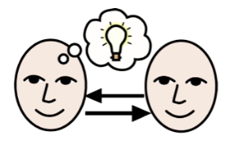
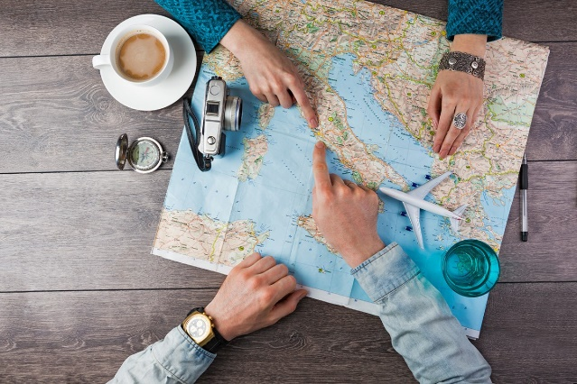
Group discussion
Name some places you’ve travelled?
Who (usually) arranges travel plan for you?
Today what helps us travel/ make travel arrangements more easily?

Slide 4
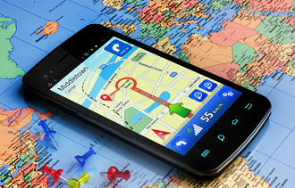

Chapter 1
Travel and technology

Slide 5
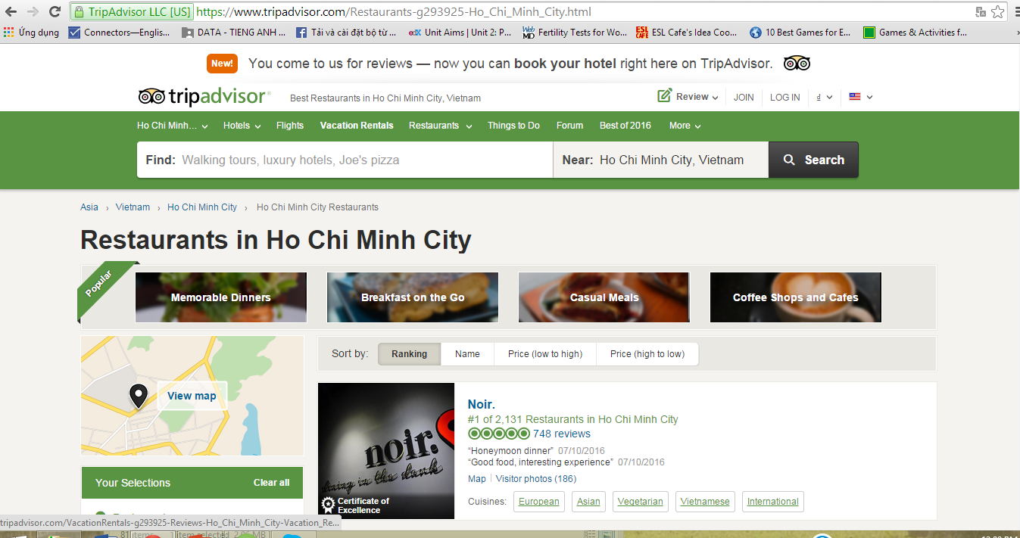
Have you ever heard of/ used these 3 technology advances:

Slide 6
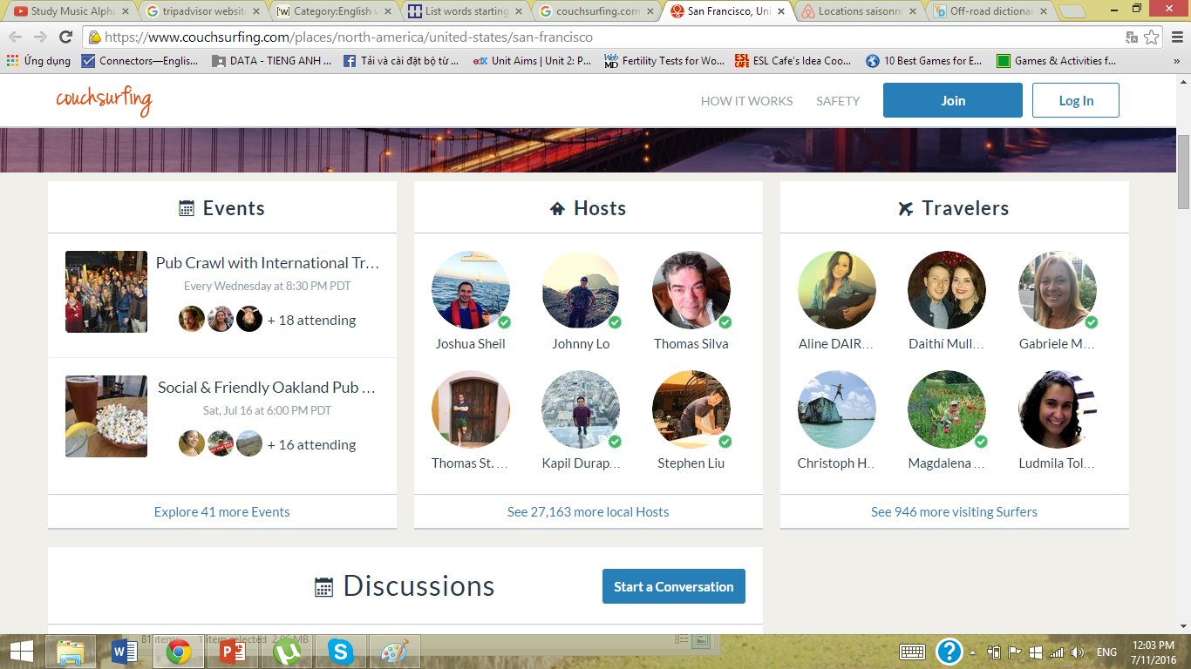
Have you ever heard of/ used these 3 technology advances:

Slide 7
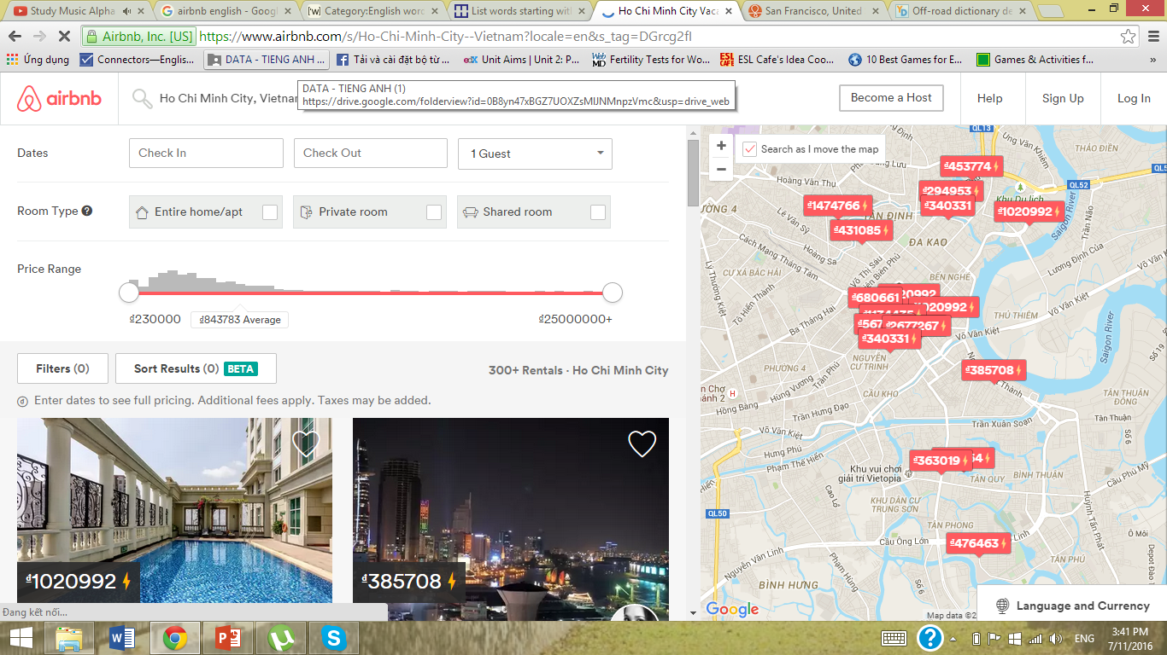
Have you ever heard of/ used these 3 technology advances:
TripAdvisor
Couchsurfing
Airbnb

Slide 8
Reading skill - Scanning
Scanning = Looking for a specific word/ phrase.
Now, look at p.13. Scan these words.
  Couch surfing
  Smartphone map
  TripAdvisor
  Airbnb
  Sightseeing apps
  Online forums
  Local hosts
If you find each word less than 5 seconds, you are a fast “scanner”
determiners

Slide 9

Reading skill - Scanning
As you’ve found the words, which one is used by Geoff, Hannah or Rajeev?
 | Geoff | Hannah | Rajeev
Couch surfing
Smartphone map
TripAdvisor
Airbnb
Sightseeing apps
Online forums
Local hosts
determiners

Slide 10
1. What kind of traveller is Geoff, Hannah or Rajeev?
2. How can TripAdvisor help Geoff? What can he find in Online forums?
3. What does Hannah love to experience? Why does she like to stay with the locals?
4. How has the technology helped Rajeev in travel now compare with before?

Slide 11
Reading comprehension - A
C
B (compare to traditional ways of making travel plans)
A (most accurate: “opinions of genuine travelers”/ helpful information = “provide tips” – L15-19)
C (L33-35)
A (L48-55)

Slide 12
Reading comprehension - B
Fewer ppl use travel agencies now, find it easier to go online to organize their own travel. (L1-6)
For leisure: good value, good food, beautiful beaches. For work: comfort & location (L21-25)
By staying with locals she finds on websites like Couchsurfing & Airbnb (L36-37)

Slide 13
Reading comprehension - B
3. By staying with locals she finds on websites like Couchsurfing & Airbnb (L36-37)
4. They don’t help him to see a city or learn about a new place & they’re expensive (L47-48)
5. G is least likely to, b’coz he’s either travel with his family or for business. These websites are more suitable for singles or backpackers (L22-23)

Slide 14

Vocabulary comprehension - A
Route
Spare
Potential
Personalize
Treasure
Add up
Navigate
Genuine

Slide 15
Vocabulary comprehension - B
Spare
Genuine
Personalize
Navigate
Treasure
Route
Adds up
Potential

Slide 16
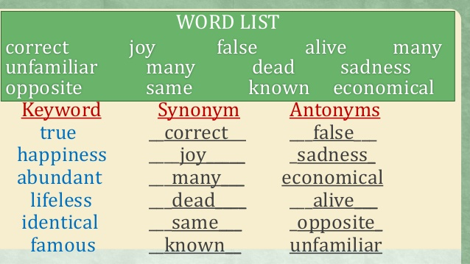
Vocabulary skill – Organizing vocabulary
Grouping words into meaningful categories to remember new words.
Group new words with words you already know that have similar/ opposite meanings
Group words by their parts of speech/ topic
determiners

Slide 17
Vocabulary skill – A
WORD | SYNONYM | ANTONYM
Genuine
Comfort
Spare
Frequently
Treasure
Authentic, true, real
Fake
Relaxation, relief
Discomfort, stress
Extra, unoccupied
Full, occupied
Usually, often
Seldom, rarely
Jewelry, wealth
burden

Slide 18
Vocabulary skill – C
Topic/ Category | WORDS
Words to describe expensive things | Treasure, value, quality
Related to money
Value, add up, treasure, spare
Describe opinions
Genuine, convincing, personalized
To use in travelling
Navigate, route

Slide 19
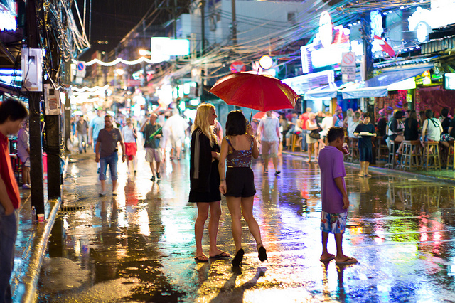
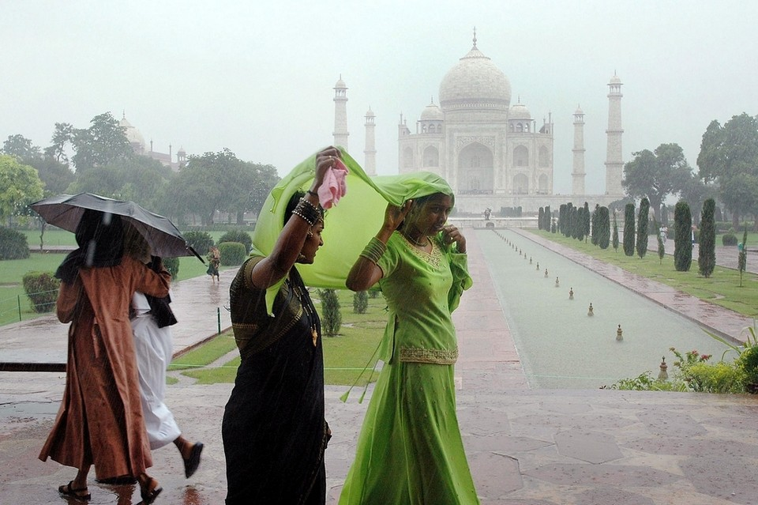
Chapter 2:
Selling India’s rainy Season
determiners

Slide 20
Before you read
Do people travel in rainy season?
What are some possible reasons why people travel in this season?
What are some activities for tourists when it rains?
determiners

Slide 21
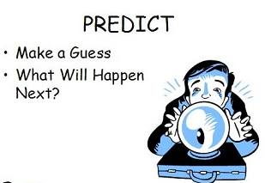
Reading skill - Predicting
Before reading, think about what you are going to read by look at the title, pictures, subheadings.
While reading, think about what comes next.
=> This helps you understand the passage better.
Now look at page 19 (title, pictures), what information you expect in this reading?
/ What can you guess about what
you are going to read?
What are we going to read?
What comes next?
determiners

Slide 22
Reading skill - Predicting
Don’t look at your book yet! Just guess the answer using your background knowledge!
1. B
2. C (L10: it affects the tourism industry)
3. B (L 36-37)
What are we going to read?
What comes next?
determiners

Slide 23
Vocabulary skill – Prefix off-
Find the sentence that includes the words “off-season”
…“They say the monsoon brings other benefits besides lower off-season prices.”…
=> Off-season: a time of reduced activities

Slide 24
Vocabulary skill – Prefix off-
No one knows about Leonardo’s off-stage life, apart from his family and childhood friends.
Off-stage: not on the stage, not where audience can see

Slide 25
Vocabulary skill – Prefix off-
What do these words have in common?
Off-season: a time of reduced activities
Off-stage: not on the stage, not where audience can see
=> Off- means away from, out of or not on

Slide 26
Real life skill – Planning a trip Online
Think of a vacation destination you’d like to visit and make a plan. Be prepared and it’s useful for you in the future!
Destination
Transportation
Accommodation
Activities
Other info
Travel tips
determiners

Slide 27
Real life skill – Planning a trip Online
Think of a vacation destination you’d like to visit and make a plan. Be prepared and it’s useful for you in the future!
 | Search word | Company | Price
Transportation
Accommodation
Activity 1
Activity 2
Activity 3
Other info
Travel tips
vehicles
where to stay
tourist activity
determiners

